Slide 1



Video Games!
Gotta collect ‘em all.

Slide 2


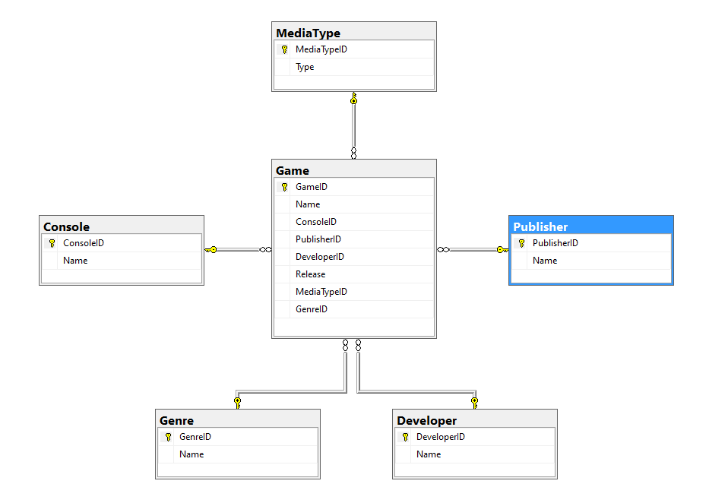

Slide 3
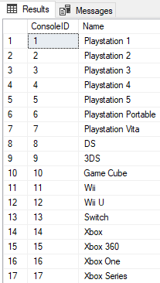
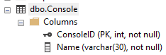
Console table

Slide 4
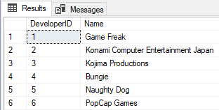
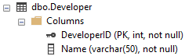
Developer table

Slide 5
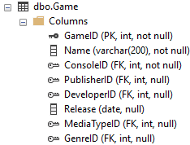
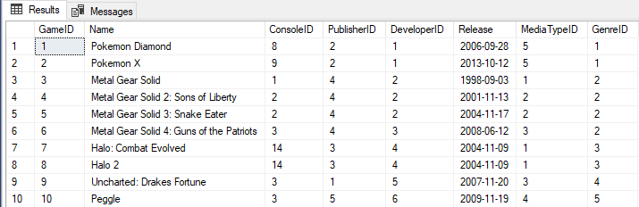
Game table

Slide 6
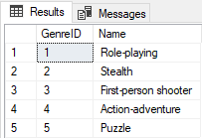
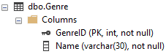
Genre table

Slide 7
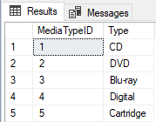
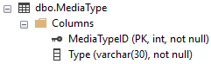
mediaType table

Slide 8
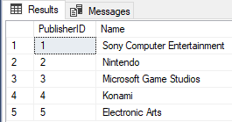
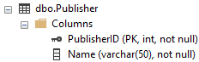
Publisher table

Slide 9
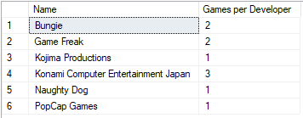
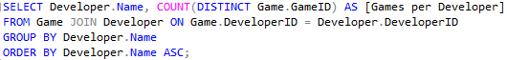
Summary Queries

Slide 10
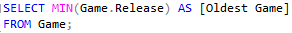
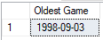
SUMMARY QUERIES

Slide 11
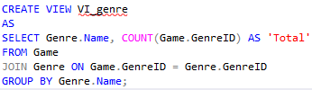
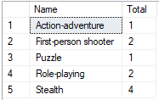
VIEWS

Slide 12
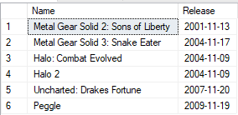
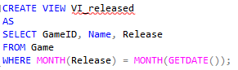
VIEWS

Slide 13
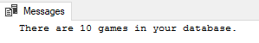
Stored Procedures

Slide 14
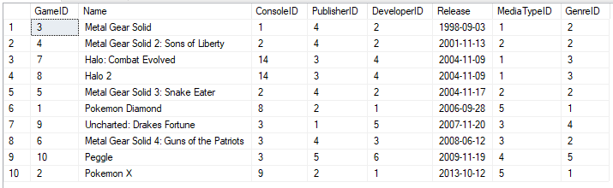
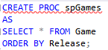
Stored Procedures

Slide 15
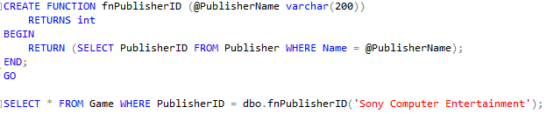
Functions
fnPublisherID – Returns ID of a Publisher when given the Name.

Slide 16
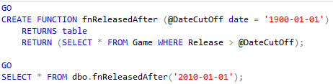
functions
fnReleasedAfter – Returns all games released after a given date.

Slide 17
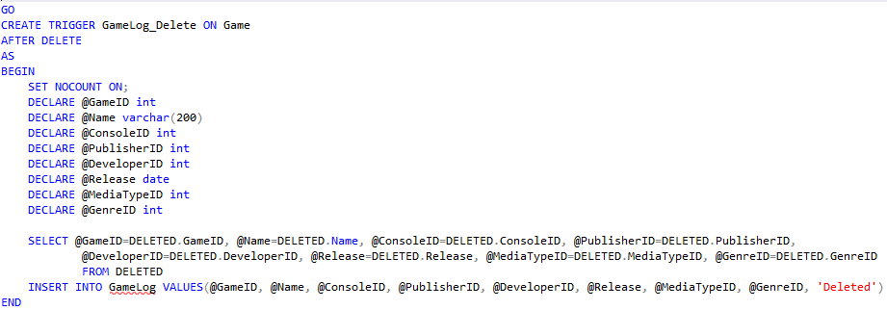
Triggers
GameLog_Delete – When a game is deleted from the database, this will trigger and add an entry to GameLog.

Slide 18
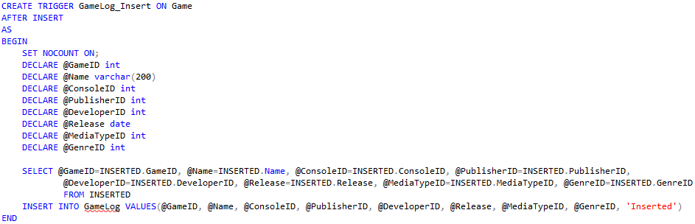
Triggers
GameLog_Insert - When a game is inserted into the database, this will trigger and add an entry to GameLog.

Slide 19
What went well?
When beginning this project, it worked well to choose a database topic I was personally interested in. This helped create interest in the project.

Slide 20
What did you have problems with?
Over the course of this project, I realized views were the area I struggled with most this semester.

Slide 21
What did you learn?
This project allowed me to practice many of the database topics covered this semester. It helped to illustrate for me the surprising depth in abilities of databases with features such as Functions and Triggers.

Slide 22
What would you like to include in future releases?
In the future, I would like to add more functions to better allow me more options in how I search the contents of the database. It currently is not very user friendly to view data in a useful way.

Slide 23
Thanks!
- Michael McLaughlin
- NMC
- CIT 178
- Fall 2021

